Slide 1
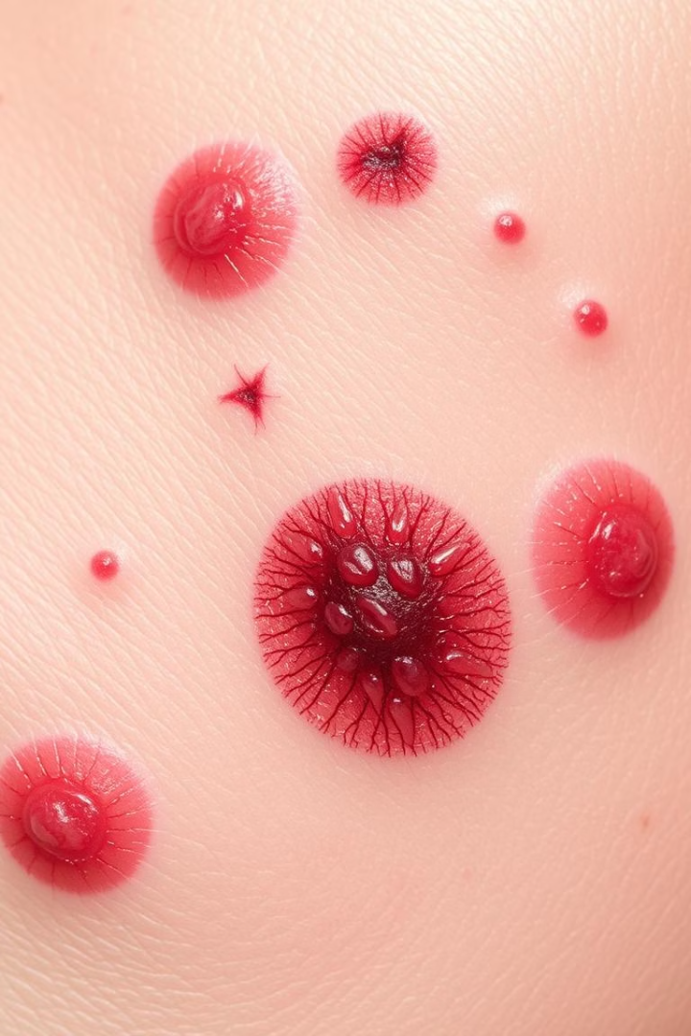

AI-Based Skin Cancer Detector
Skin cancer includes melanoma, basal cell carcinoma, and squamous cell carcinoma.
1 in 9 Indians is likely to develop some form of skin cancer in their lifetime,
making early detection absolutely critical.
Team Members: UNNATI ( E23CSEU1067) ABDULLAH (E23CSEU1057) AVANISH (E23CSEU1055) Under the guidance of : Dr. Shwetang Dubey

Slide 2
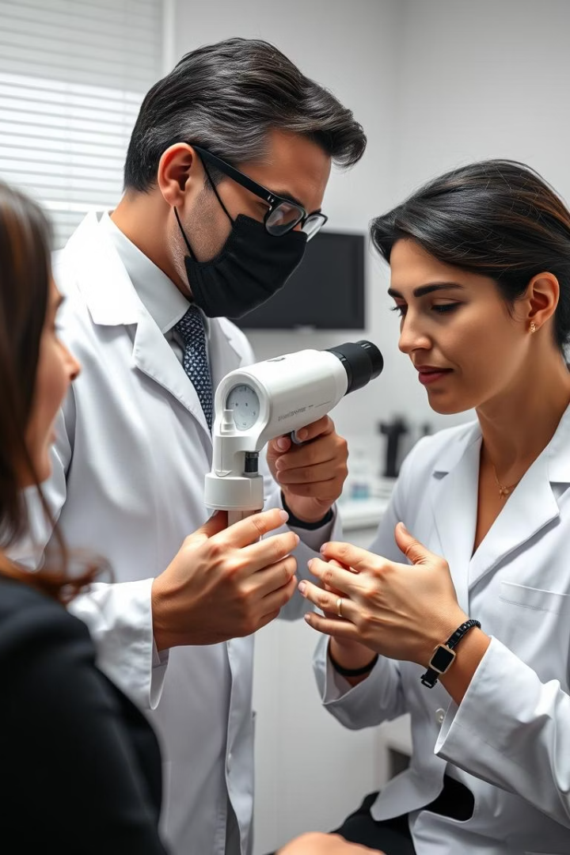
Problem Statement: Limitations of Manual Diagnosis
Subjectivity & Delay
Invasive Biopsies
Visual inspections vary and average specialist wait is 6-12 months.
Biopsies are costly ($200-$500), invasive, and time-consuming.
Limited Dermatologists
India has approximately 12,917 dermatologists .
With a population nearing 1.4 billion, this equates to roughly
0.92 dermatologists per 100,000 people.​.

Slide 3
Proposed Solution: AI-Powered Early Detection
Non-Invasive
Improved Access
Cost-Effective
Uses images for quick, painless assessment without biopsies.
Supports telemedicine, enabling remote diagnosis and consultations.
Reduces need for costly procedures, lowering healthcare expenses.

Slide 4
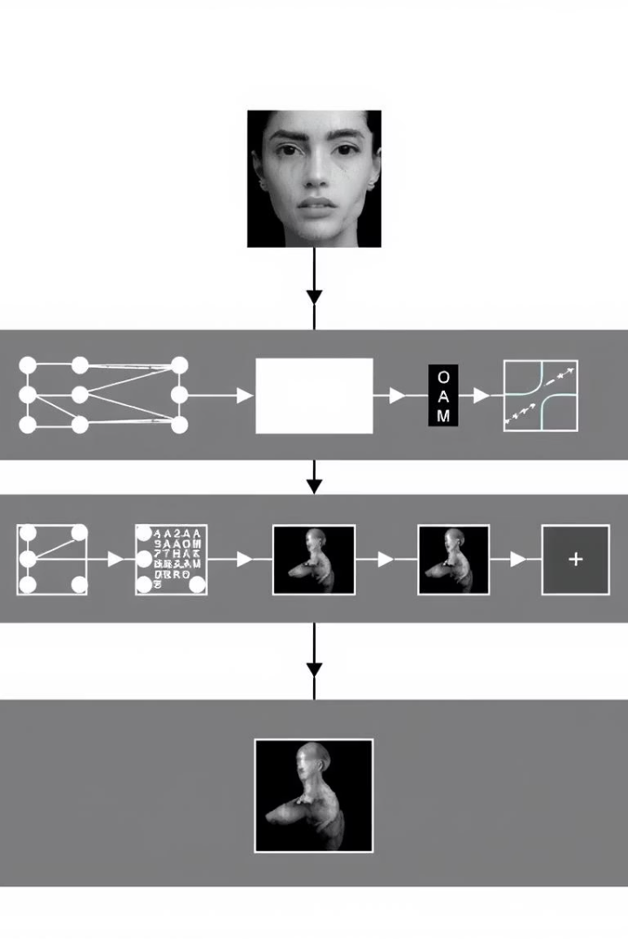
AI/ML Implementation: Convolutional Neural Networks (CNNs)
Models Used
Large Dataset
MobileNetV2 for transfer learning
Over 10,000 dermatoscopic images from Kaggle.
Techniques
Data augmentation and transfer learning enhance model accuracy.

Slide 5

Training and Performance Metrics
Accuracy
71%
Sensitivity (Recall)
72%
F1-score
67%

Slide 6





Workflow Diagram
Image Input
Dermoscopic image acquisition.
Preprocessing
Resizing and noise reduction applied.
AI Model
Convolutional neural network analyzes image.
Prediction
Classifies lesion as benign or malignant.
Result
Outputs probability score for diagnosis.

Slide 7

Results and Benefits
Reduced Biopsies
Faster Diagnosis
Improved Accuracy
30% fewer biopsies in pilot studies, lowering patient discomfort.
Instant results replace days or weeks wait time.
Outperforms traditional visual inspection by reducing false negatives.

Slide 8
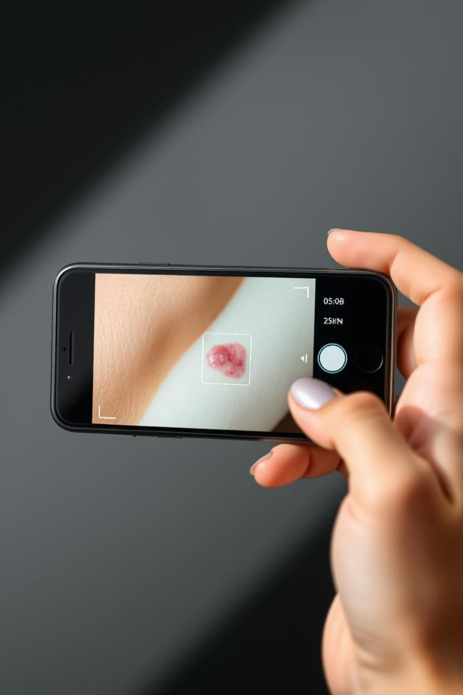


Future Scope
Mobile Integration
Real-time analysis through smartphone health apps.
Broader Skin Conditions
Expand AI diagnostics to eczema, psoriasis, and others.
Continuous Learning
Ongoing model improvement with new clinical data.
Clinical Collaboration
Partner with dermatologists for validation and adoption.

